Slide 1


NEXT GEN EMPLOYABILITY PROGRAM
CREATING A FUTURE-READY WORKFORCE
Student Name :
Poshala Prabhanjali
Student ID :
College Name :
XYZ

Slide 2
CAPSTONE PROJECT SHOWCASE
Project Title
Project Management Tool with React and ExpressJS Framework
Abstract | Problem Statement | Project Overview | Proposed Solution | Technology Used | Modelling & Results | Conclusion | Q&A

Slide 3
Abstract
1
Introduction to project management challenges
2
Importance of an efficient project management tool
3
Role of React for frontend and ExpressJS for backend
4
Objective: Creating a seamless and user-friendly project management tool

Slide 4


Problem Statement
- Inefficiency in task management and tracking
- Difficulty in team collaboration & communication
- Lack of real-time updates and centralized system
- Need for a modern, scalable, and responsive solution

Slide 5

Project Overview
- A web-based project management system
- Helps teams plan, track, and collaborate on tasks
- Provides intuitive UI, notifications, and task management features
- Aims to improve workflow efficiency and productivity

Slide 6
Proposed Solution
- A web-based project management system
- Helps teams plan, track, and collaborate on tasks
- Provides intuitive UI, notifications, and task management features
- Aims to improve workflow efficiency and productivity

Slide 7
Technology used
- Frontend: React.js, Redux, Tailwind CSS/Bootstrap
- Backend: Node.js, Express.js
- Database: MongoDB / PostgreSQL
- Authentication: JWT, OAuth
- Deployment: Vercel, Netlify, AWS

Slide 8
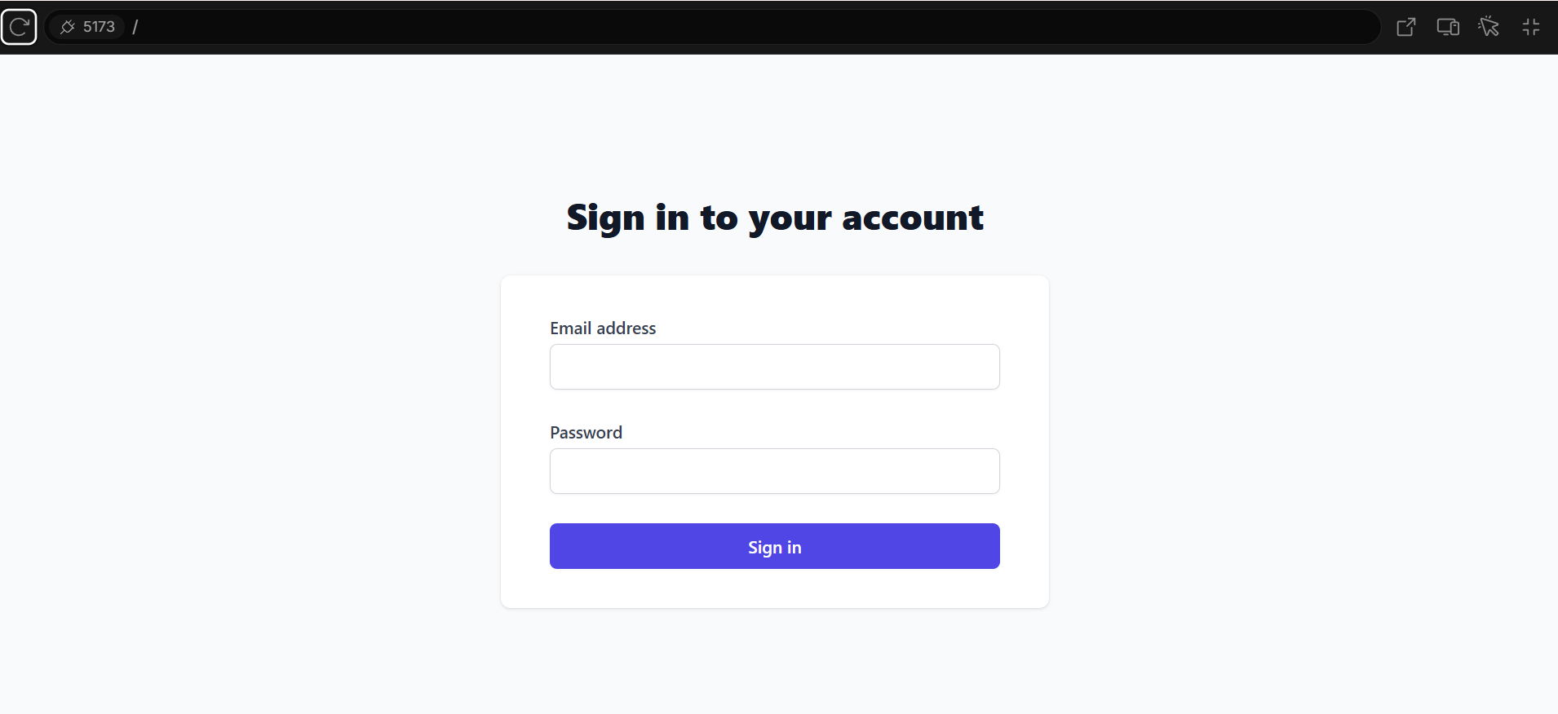
Modelling & Result

Slide 9
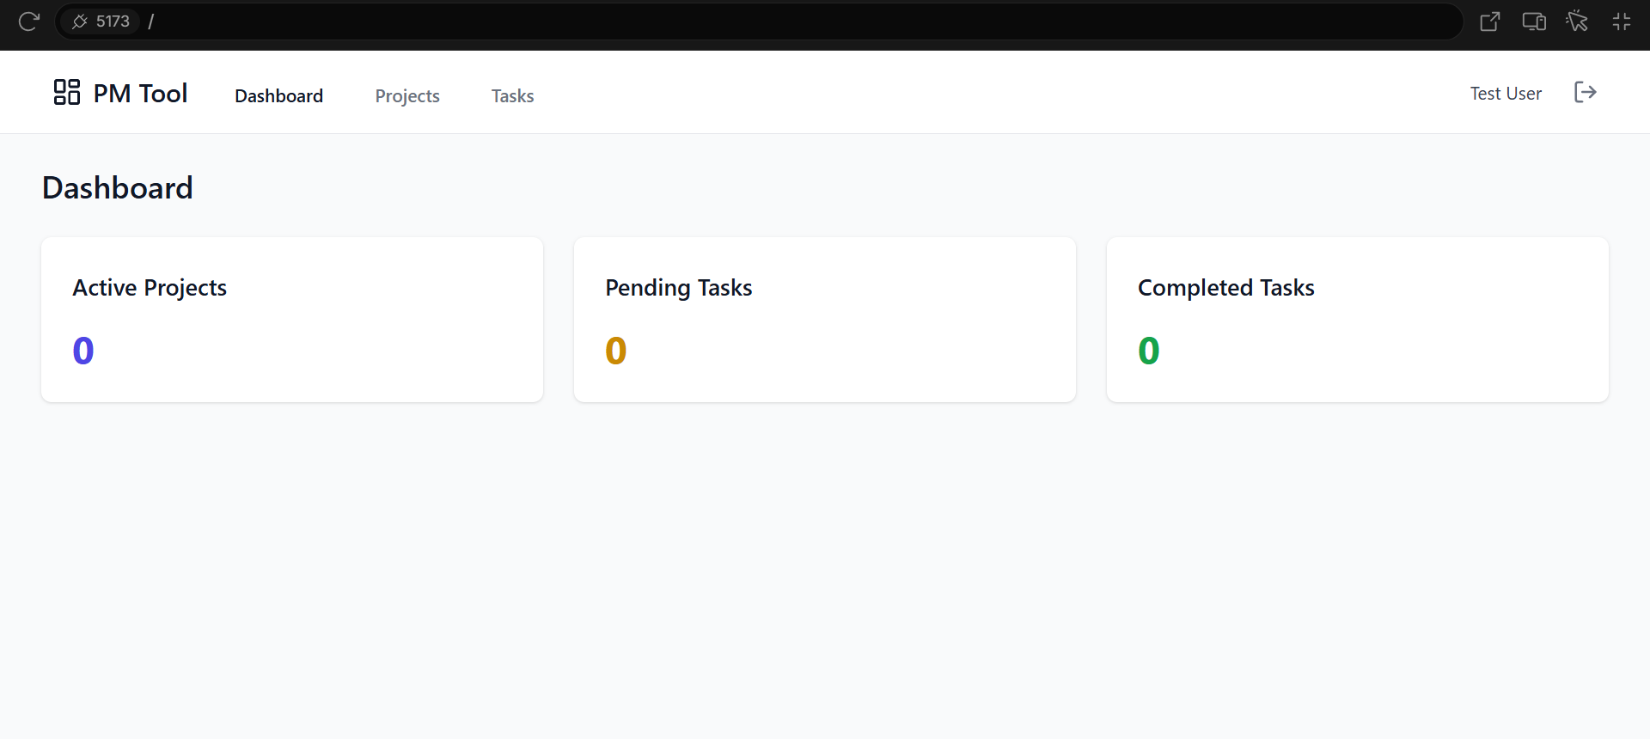
Modelling & Result

Slide 10
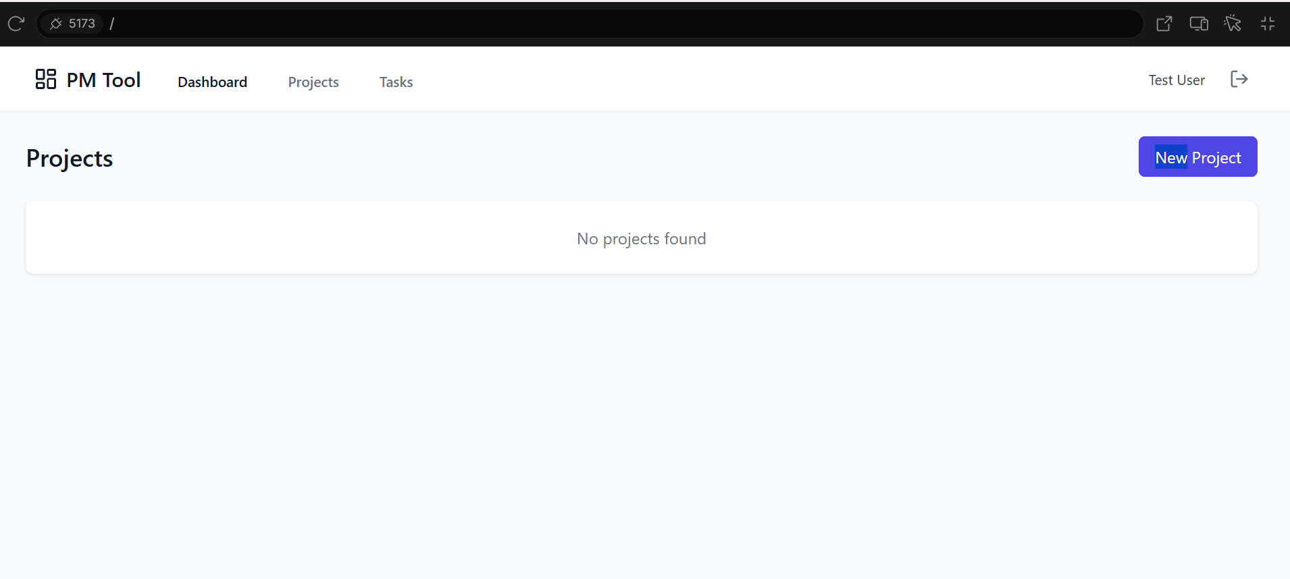
Modelling & Result
- Wireframe designs and UI screenshots
- Performance benchmarks (load time, API response)
- User feedback (if any)

Slide 11

Conclusion
- Project summary and impact
- Future improvements: AI-based task recommendations, integrations with third-party apps

Slide 12


Notes:
Thank You !!

